Slide 1

The Evolution of Cryptography:
An Overview of Classical Ciphers
Christopher Gonzalez, Joseph Ipanaque, Isaia Jimenez, Daniel Minton

Slide 2
Group Member Introductions
Christopher Gonzalez - Developed/implemented Caesar & Columnar Transposition Ciphers in C++, research on encryption/decryption techniques.
Joseph Ipanaque - Developed/implemented ROT13 & XOR cipher algorithms in C++, research on encryption/decryption techniques.
Isaia Jimenez - Developed/implemented Atbash & Affine cipher algorithms in C++, research on encryption/decryption techniques.
Daniel Minton - Developed/implemented Rail Fence & Vigenère cipher algorithms in C++, research on encryption/decryption techniques.

Slide 3
Project Idea
Create a Secure Communication System that demonstrates classical encryption methods through a C++ menu-based program.
Showcase the evolution of cryptography by including simple ciphers like Atbash and Caesar, up to more complex ones like Vigenère and XOR.
Help users understand how encryption has transformed from basic letter substitutions to operations involving modular arithmetic and bitwise logic.
Provide an educational tool that visually and interactively demonstrates how each cipher works — great for learning or teaching cybersecurity basics.

Slide 4
Research Done
While researching to identify eight distinct encryption and decryption ciphers, it was discovered that many were built off the techniques of predecessors
Research was performed on ciphers from the earliest days of the concept, to ciphers implemented alongside modern computing capabilities
C++ was the programming language of choice due to familiarity from previous cryptography applications, and was cemented as the right choice with its excellent memory handling capabilities and object-oriented nature
A multitude of cipher and programming resources were used to understand the underlying theory of each cipher, to include TutorialsPoint and GeeksforGeeks

Slide 5
Code Developed
Functions Used for Each Cipher
The majority of the ciphers are written as a separate function (e.g., atbashCipher(), encryptDecrypt() for XOR).
This modular approach keeps the code clean, reusable, and easy to debug.
Menu System with Switch Statement A main menu loop lets users select a cipher (1–8, with option 9 serving as a random option and 10 to end the session). A switch statement runs the correct code block based on the user’s choice. Each case handles its own inputs, outputs, and logic for encryption/decryption.
Input Validation & Exception Handling We used cin.fail(), cin.clear(), and cin.ignore() to prevent program crashes. Input is repeatedly requested until the user enters valid data. This ensures the program is user-friendly and resistant to bad inputs.
Libraries Included #include <iostream> – handles input and output #include <string> – manages user text input #include <limits> – enables safe input validation #include <bits/stdc++.h>– provides advanced functions like transform() and memset() for complex cipher logic.

Slide 6
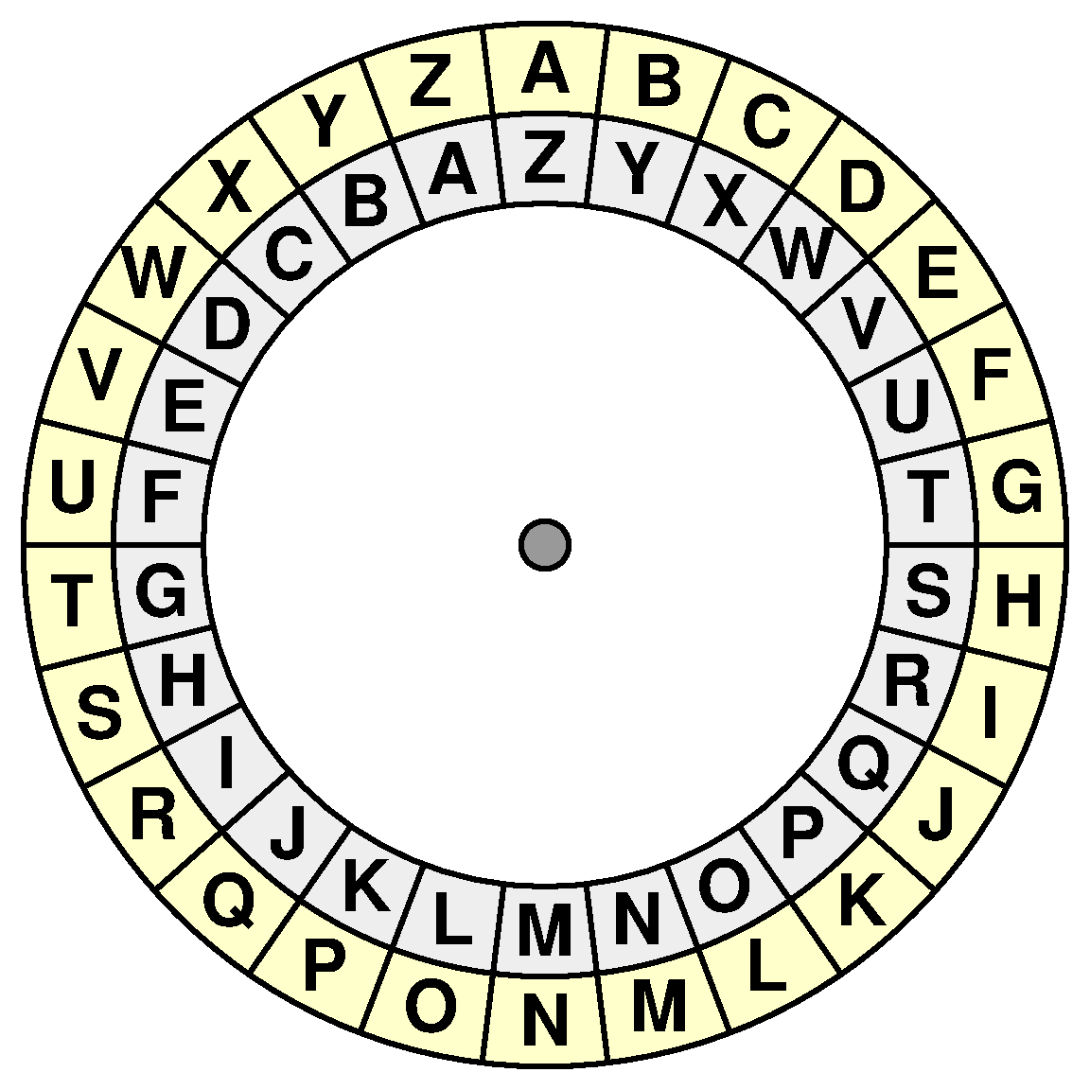
Code Demo (With Supporting Visuals)
Atbash Cipher
Plaintext: ATBASH CIPHER
Transformation: Alphabet is reversed
Ciphertext: ZGYZHS XRKSVI

Slide 7
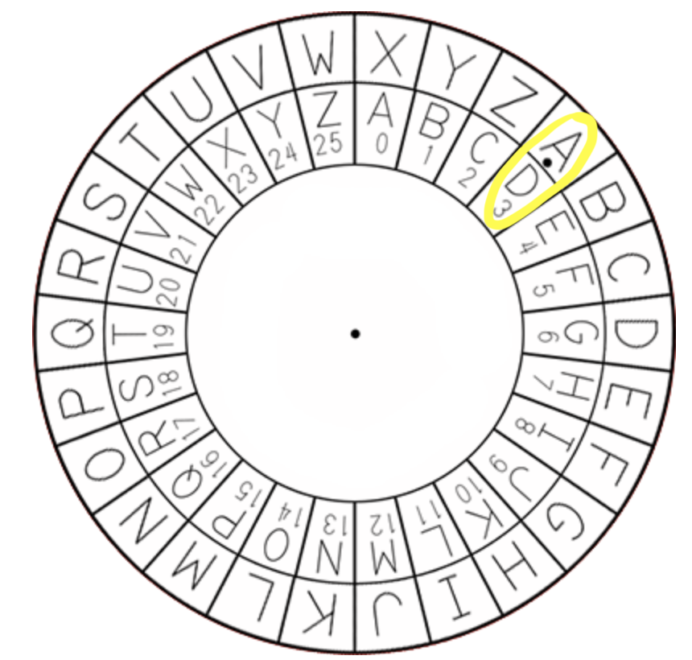
Caesar Cipher
Plaintext: CAESAR CIPHER
Shift: 3 spaces to the right
Ciphertext: FDHVDU FLSKHU

Slide 8
Rail Fence Cipher
Plaintext: RAIL FENCE CIPHER (spaces also included for encryption/decryption)
Number of Rails: 3
Ciphertext: R CIRALFNECPEIE H
1
2
3
R |  |  |  |  |  |  |  | C |  |  |  | I |  |  |  | R
 | A |  | L |  | F |  | N |  | E |  | C |  | P |  | E
 |  | I |  |  |  | E |  |  |  |  |  |  |  | H

Slide 9
Columnar Transposition Cipher
Plaintext: CTC_CIPHER (Underscores are used to represent spaces/padding)
Keyword: KEY
Ciphertext: TCH_C_PRCIE_ 2 1 3
K | E | Y
C | T | C
_ | C | I
P | H | E
R | _ | _

Slide 10
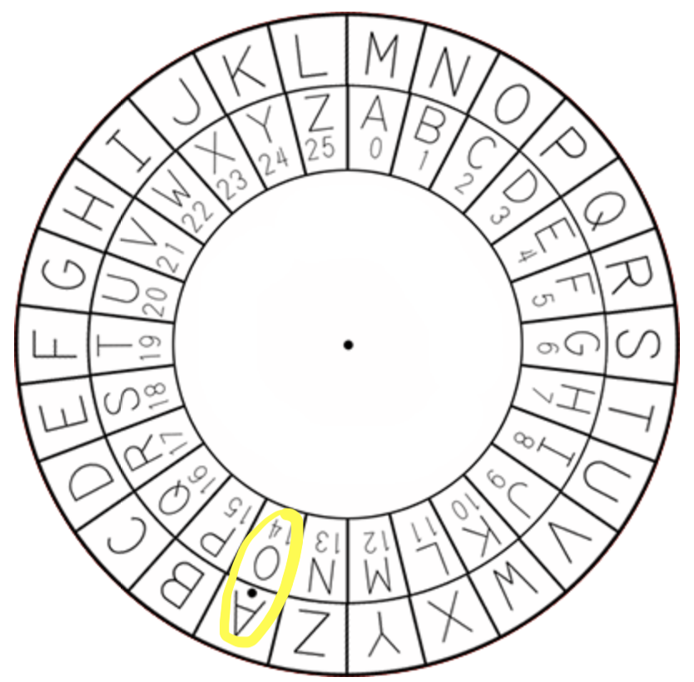
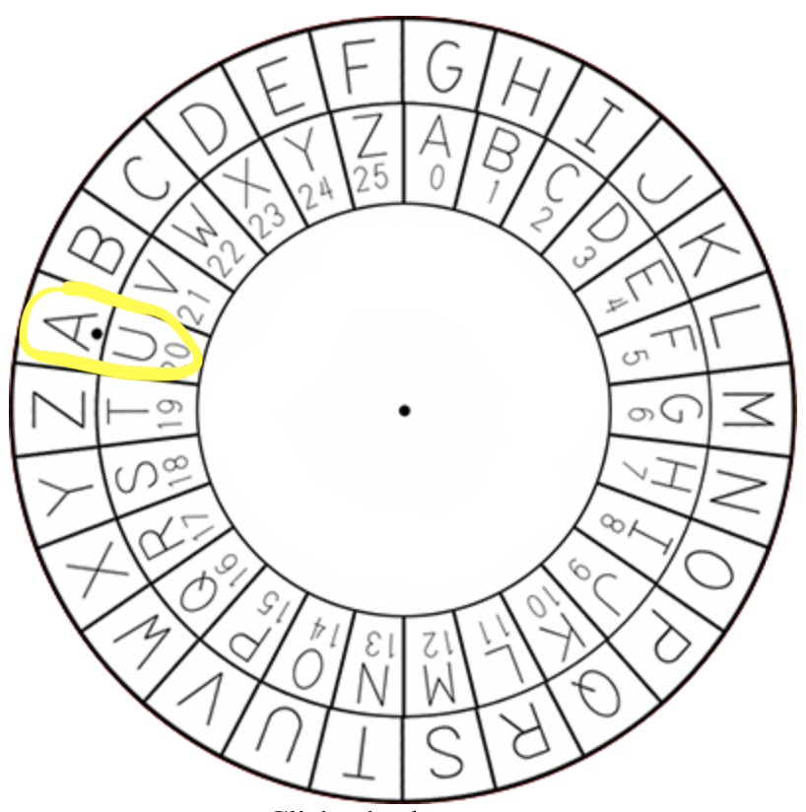
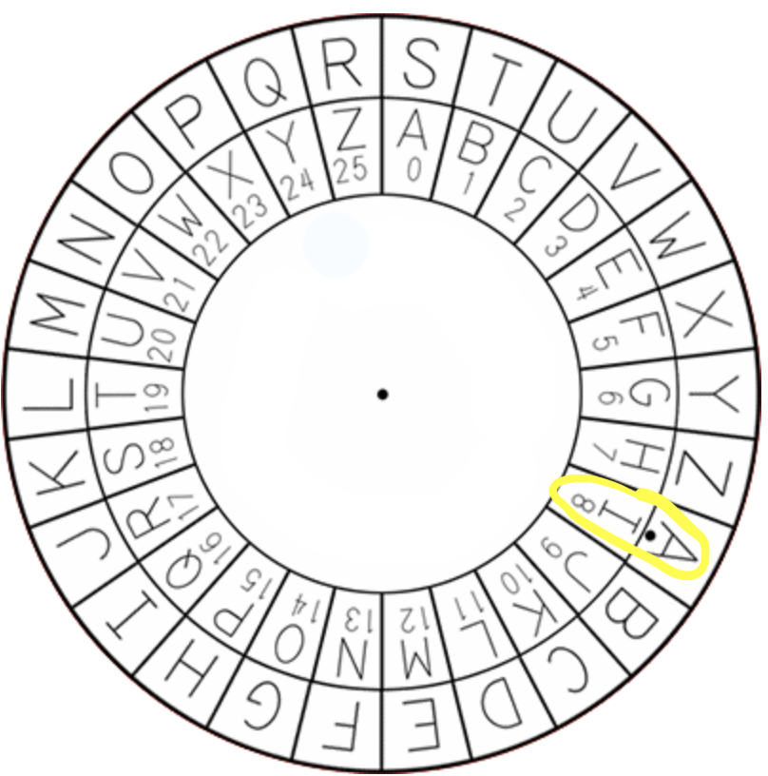
Vigenère Cipher
Plaintext: VIGENERE
Key: OUI
Ciphertext: JCOSHMFY
V | I | G | E | N | E | R | E
O | U | I | O | U | I | O | U
J | C | O | S | H | M | F | Y

Slide 11
Affine Cipher
Plaintext: AFFINE CIPHER
Keys: a = 5, b = 8
Encryption: C = (aM + b) mod 26; M is the numerical position of plaintext character.
Decryption: M = (a⁻¹ * (C - b)) mod 26; C is the ciphertext numerical value.
Ciphertext: IHHWVC SWFRCP
A | F | F | I | N | E |  | C | I | P | H | E | R
(0) | (5) | (5) | (8) | (13) | (4) |  | (2) | (8) | (15) | (7) | (4) | (17)
(8) | (7) | (7) | (22) | (21) | (2) |  | (18) | (22) | (5) | (17) | (2) | (15)
I | H | H | W | V | C |  | S | W | F | R | C | P

Slide 12
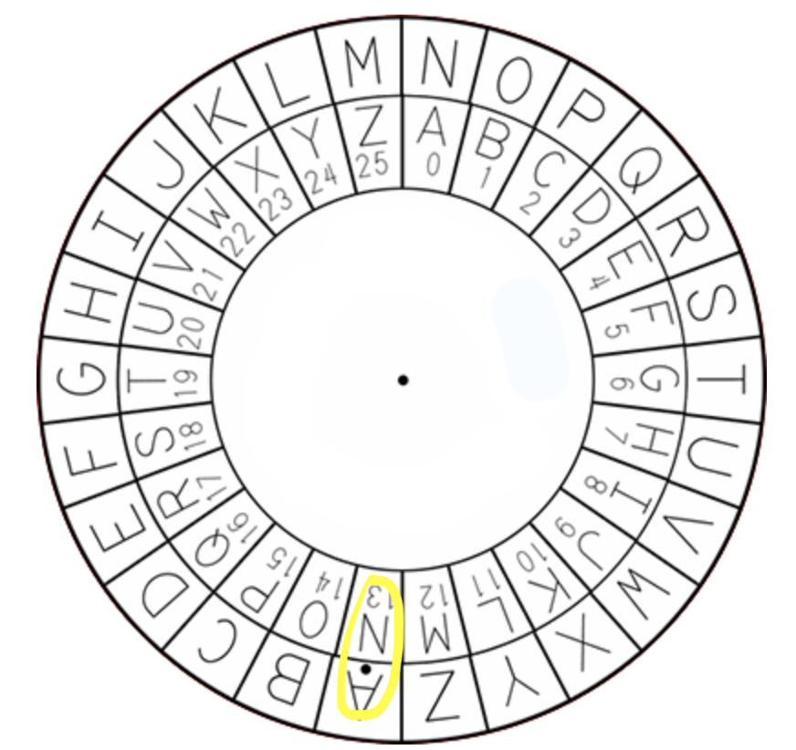
ROT13 Cipher
Plaintext: ROTTHRTN CIPHER
Shift: 13 spaces
Ciphertext: EBGGUEGA PVCURE

Slide 13
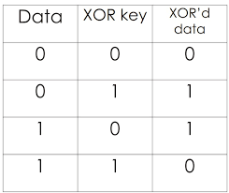
XOR Cipher
Plaintext: XOR
Key: t
X (binary) 01011000
t (binary) 01110100
00101100
Ciphertext = ,;&
00101100 = ,
Note: The XOR Cipher can result in unprintable characters.
⊕
X | O | R
⊕ | ⊕ | ⊕
t | t | t
, | ; | &

Slide 14
Lessons Learned
Early ciphers are susceptible to brute-force attacks. Later cryptographic techniques began to rely on more complex algorithms and longer keys.
These ciphers exhibited predictable patterns. A strong cipher should produce output that is unpredictable and indistinguishable from random data.
As human intelligence and technological tools advance, there will never be a cryptographic technique can be definitively considered as "unbreakable".
It's important for people to learn from the weaknesses of early cryptographic techniques in order to develop stronger, more resilient security systems.

Slide 15
Thank You.

